Slide 1

Practical Training DevOps Summer School
Exploring DevOps principles and tools learned during summer training at Dronacharya College of Engineering.
By: Pranavi Gote
Roll No. 25118

Slide 2

Introduction
1
Objective
2
Purpose
3
Presentation Overview
Deep dive into DevOps technologies.
Understanding DevOps tools for efficient software development and IT operations.
Technologies, implementation, and key learnings.

Slide 3
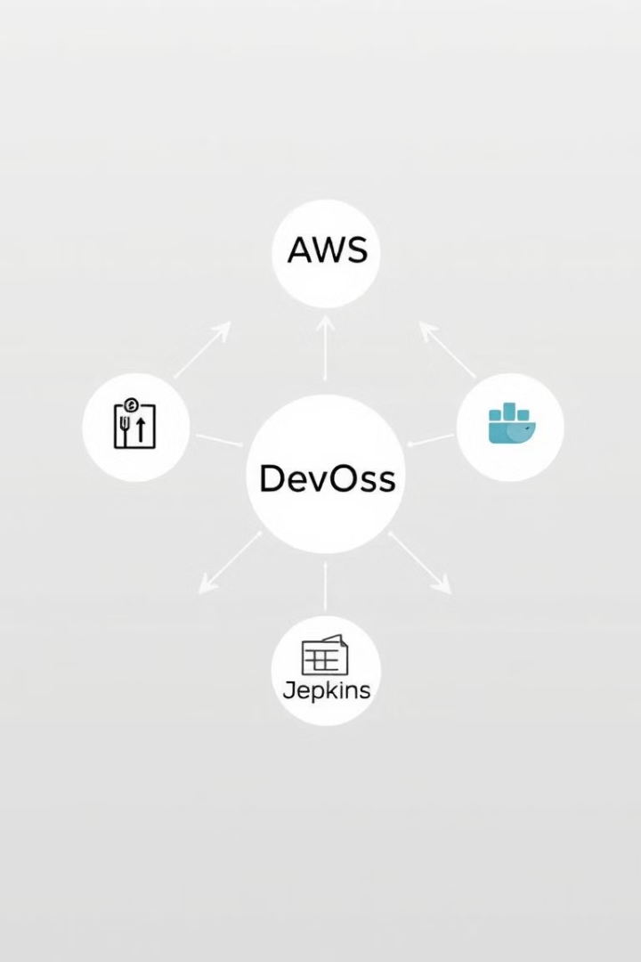
Technologies Covered
Git & GitHub
Version Control and Collaboration
AWS
Cloud Computing for Scalable Infrastructure
DevOps
Docker
Linux Command Line
System Management and Scripting
Linux Command Line
Git & GitHub
Jenkins
Docker
Containerization for Consistent Deployments
Jenkins
CI/CD Pipelines for Automation

Slide 4
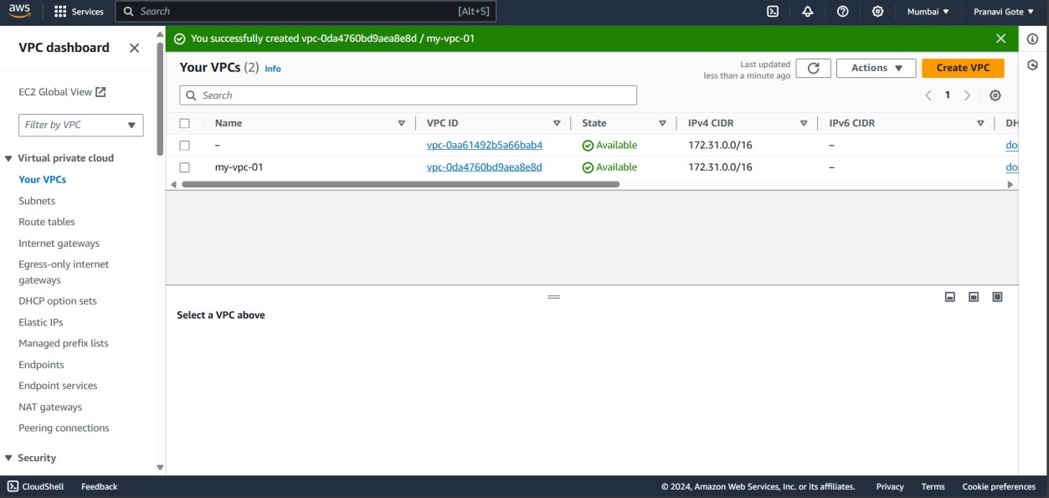
Implementation Overview
1
Step 1
Creating IAM Users and a VPC.
VPC

Slide 5
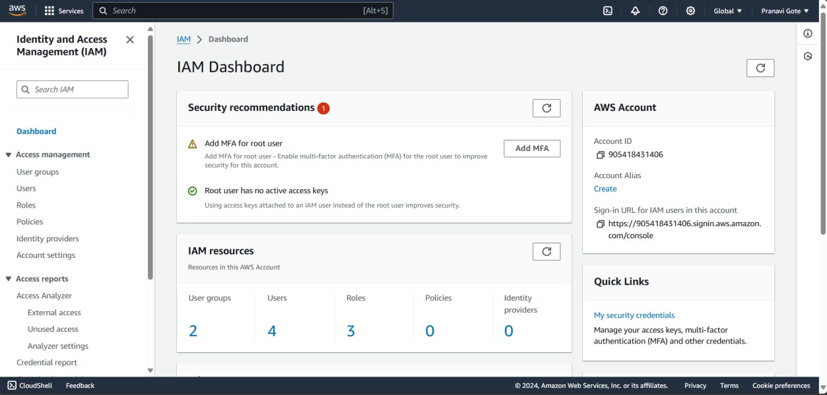
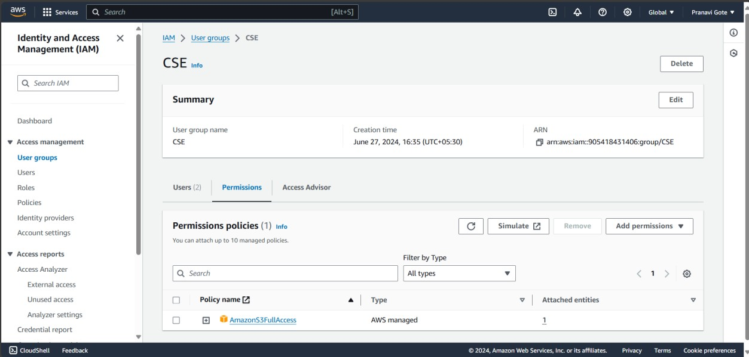
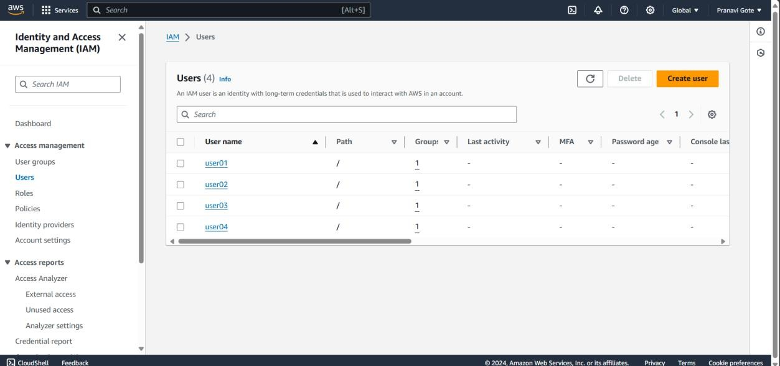
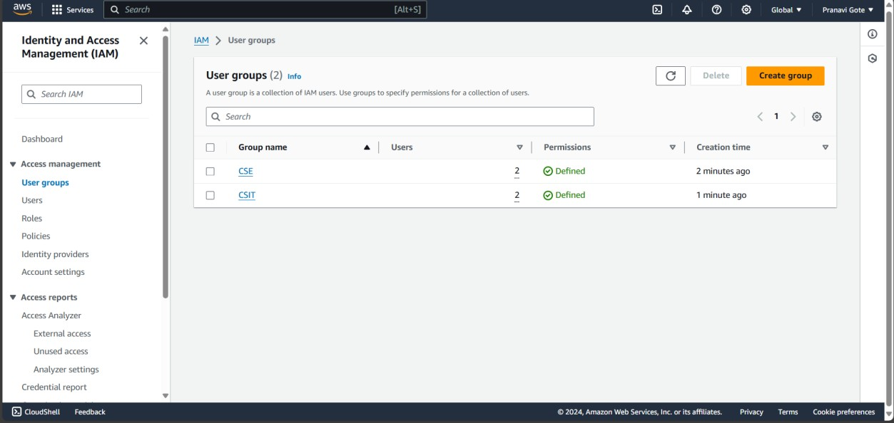
IAM users

Slide 6
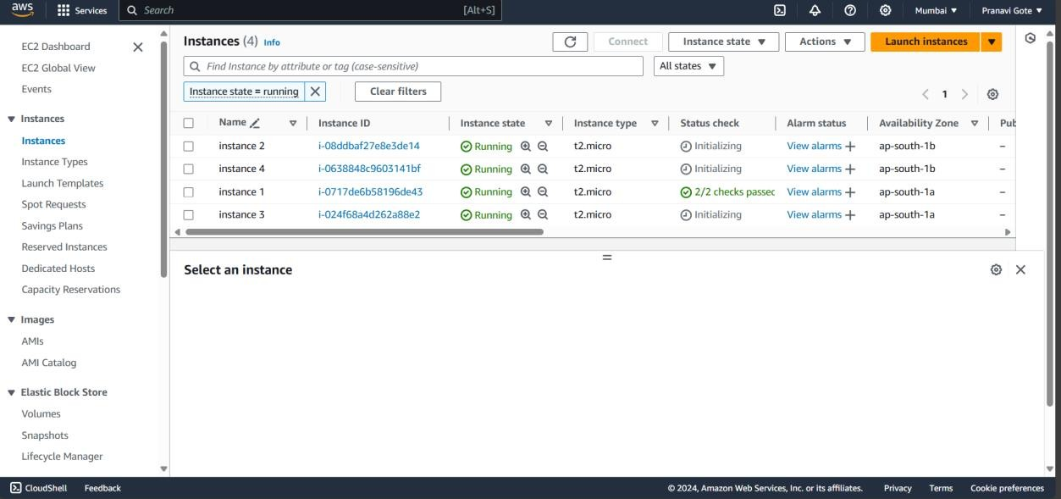
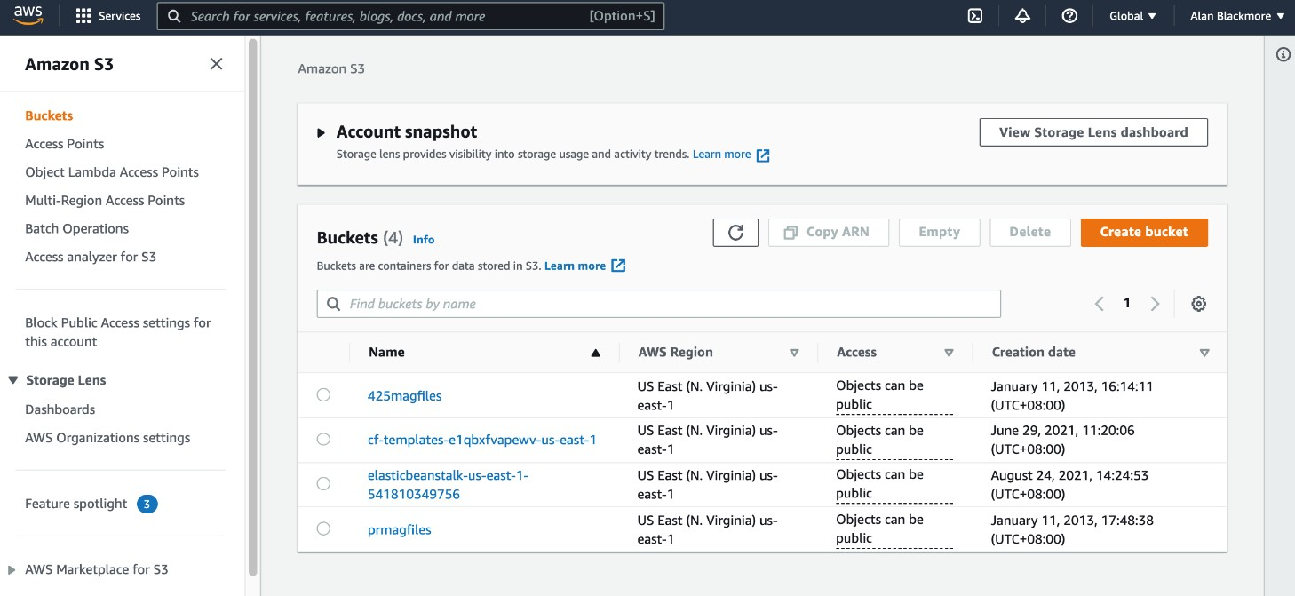
2
Step 2
Launching EC2 instances and configuring S3.
Instances
S3 Buckets

Slide 7
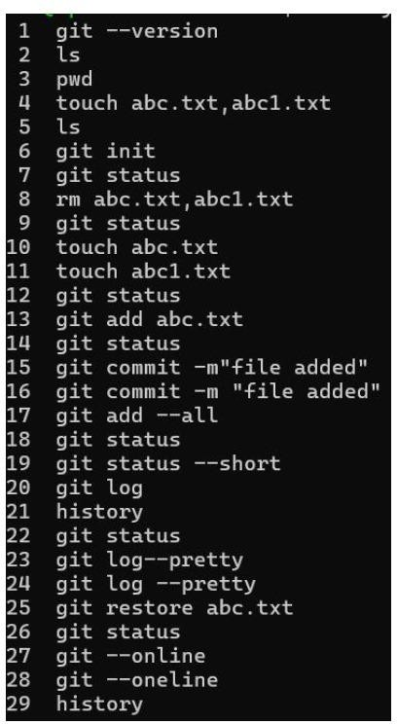
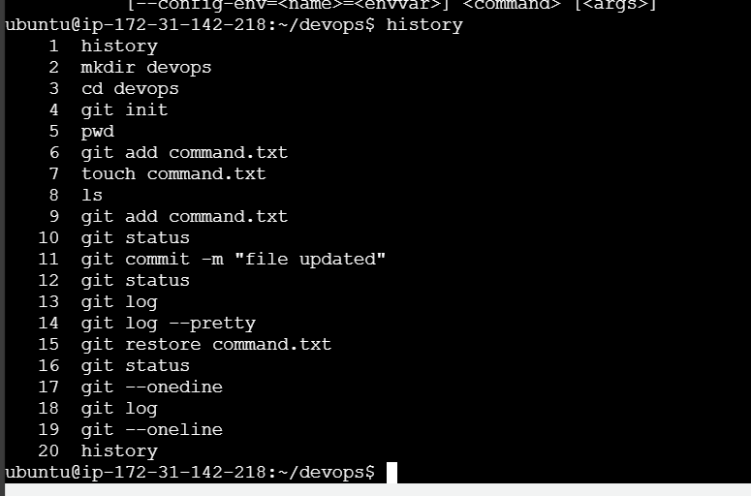
3
Step 3
Setting up a Git repository for version control.

Slide 8
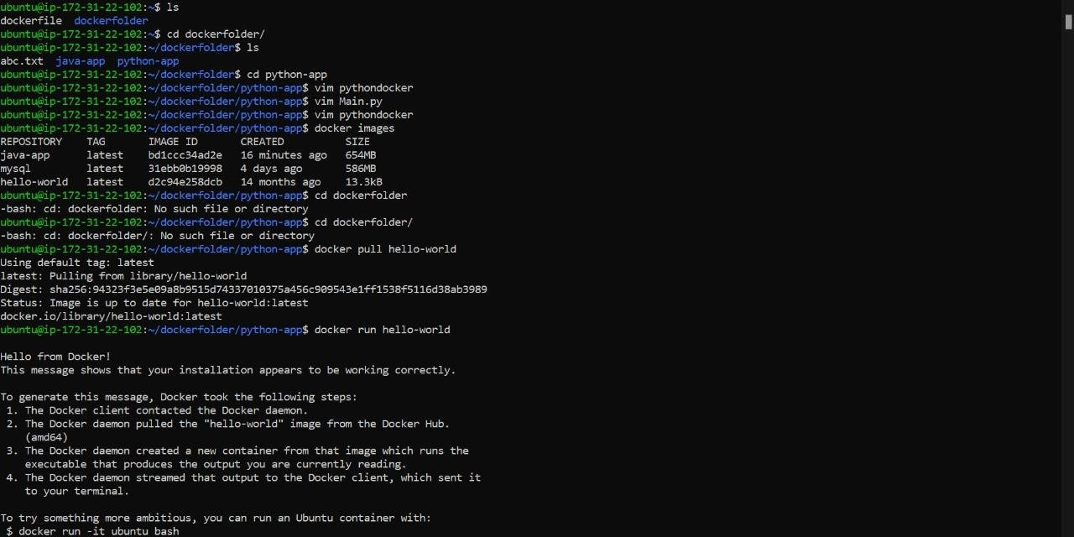
4
Step 4
Building and running Docker containers.

Slide 9
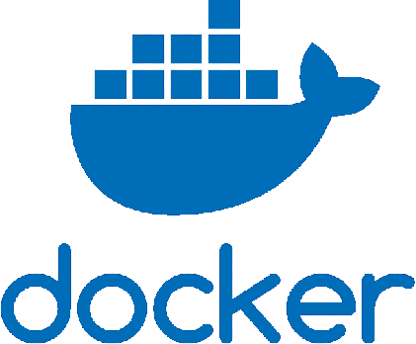



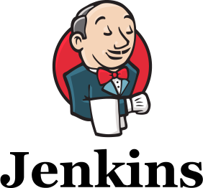
Key Learnings
Git/GitHub
AWS
Linux Commands
Enhanced teamwork and code management.
Scalable IT infrastructure and reliable cloud services.
Efficient system operations and automation.
Docker
Jenkins
Faster deployments and environment consistency.
Streamlined software delivery pipelines.

Slide 10
Results and Impact
Results
Impact
Reduced deployment errors.
Prepared for real-world DevOps challenges.
Faster application delivery cycles.
Improved collaboration and efficiency.

Slide 11




Challenges Faced
Challenge 1
Challenge 2
Challenge 3
Initial difficulties with Dockerfile syntax.
Managing AWS configurations for VPC and EC2.
Debugging issues in Jenkins pipelines.

Slide 12



Conclusion
Summary
Future Scope
Practical training reinforced core DevOps concepts and tools.
Applying learnings to real-world projects and advanced CI/CD pipelines.

Slide 13


